Slide 1
LAN Connections
Exploring the Packet Delivery Process

Slide 2
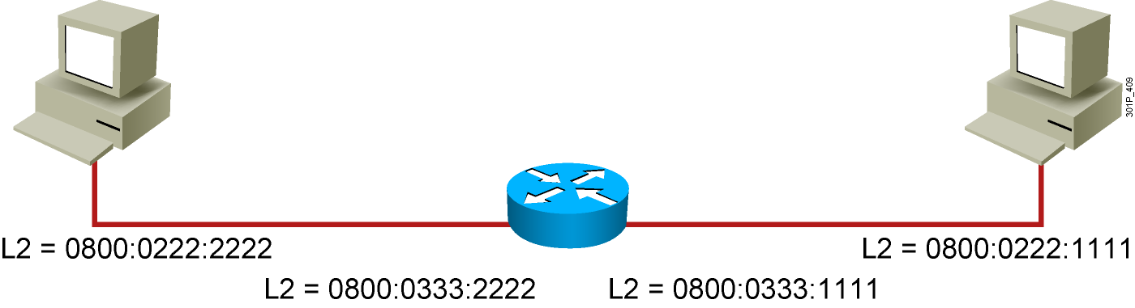
Layer 2 Addressing
Notes:
Lesson Aim
<Enter lesson aim here.>

Slide 3
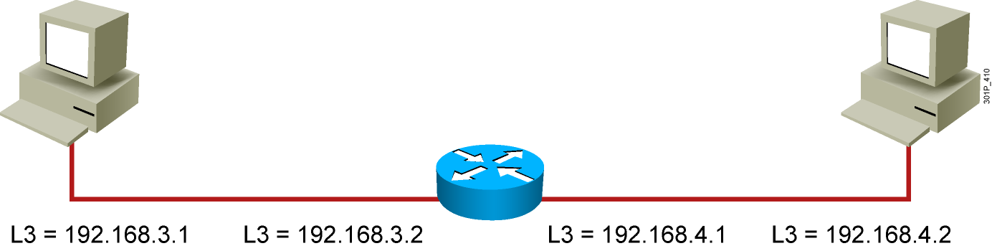
Layer 3 Addressing
Notes:
Lesson Aim
<Enter lesson aim here.>

Slide 4
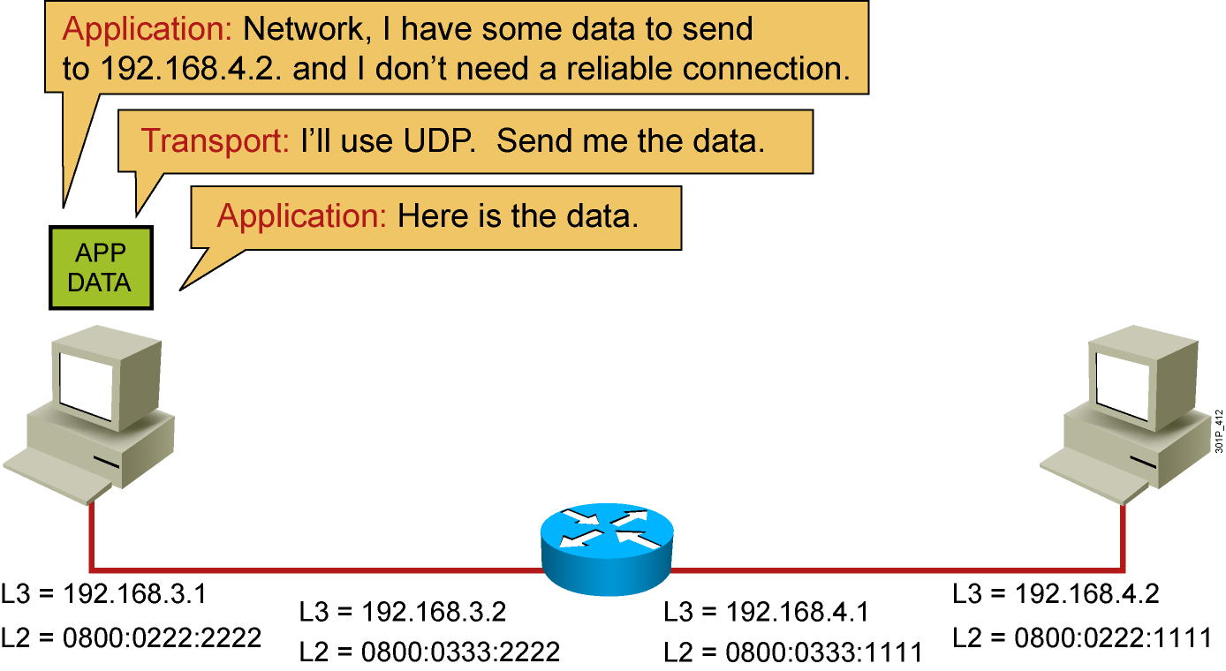
Host-to-Host Packet Delivery (1 of 17)
Notes:
Lesson Aim
<Enter lesson aim here.>

Slide 5
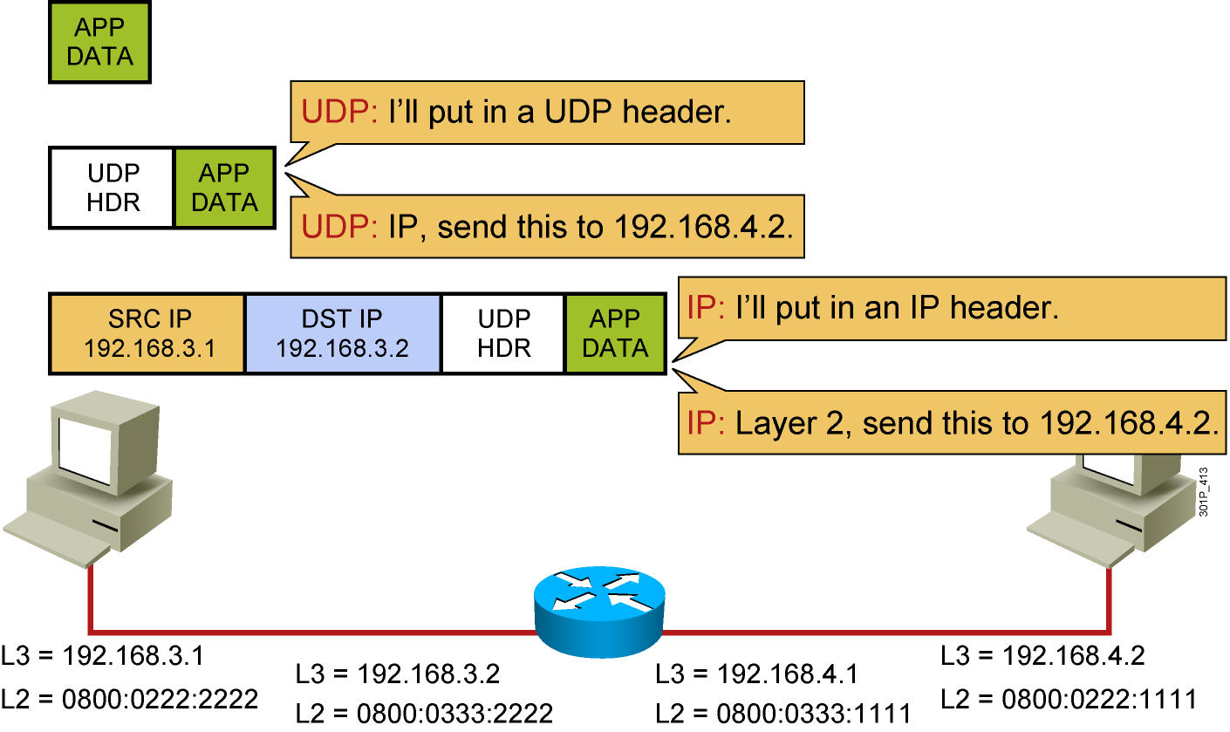
Host-to-Host Packet Delivery (2 of 17)
Notes:
Lesson Aim
<Enter lesson aim here.>

Slide 6
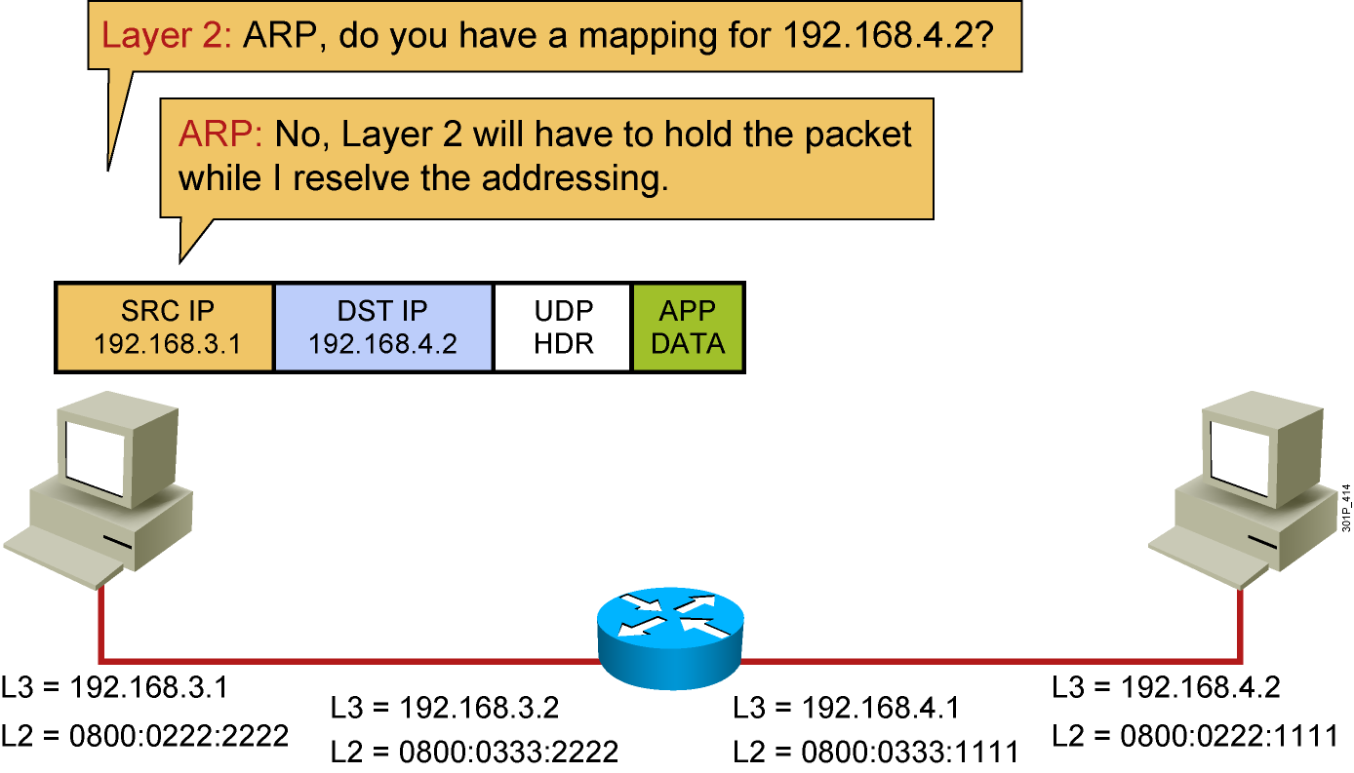
Host-to-Host Packet Delivery (3 of 17)
Notes:
Lesson Aim
<Enter lesson aim here.>

Slide 7
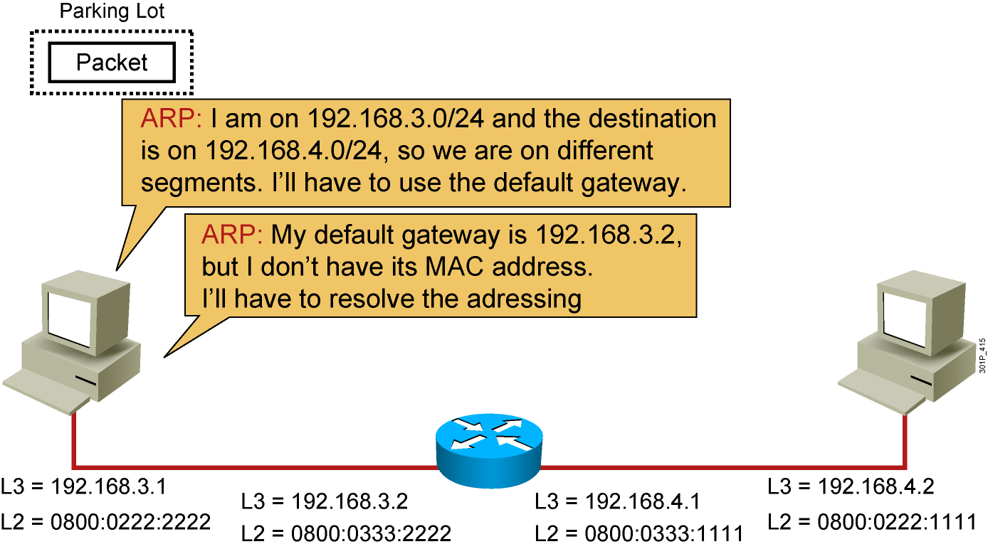
Host-to-Host Packet Delivery (4 of 17)
Notes:
Lesson Aim
<Enter lesson aim here.>

Slide 8
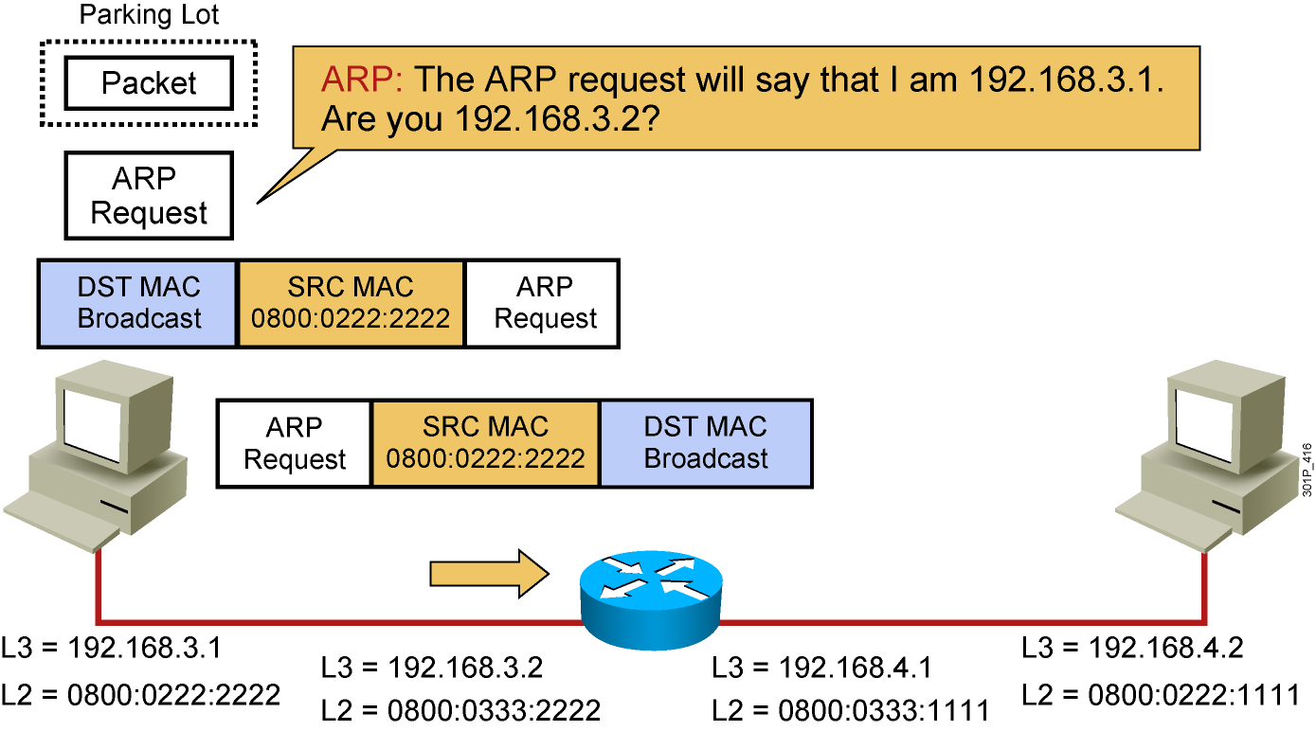
Host-to-Host Packet Delivery (5 of 17)
Notes:
Lesson Aim
<Enter lesson aim here.>

Slide 9
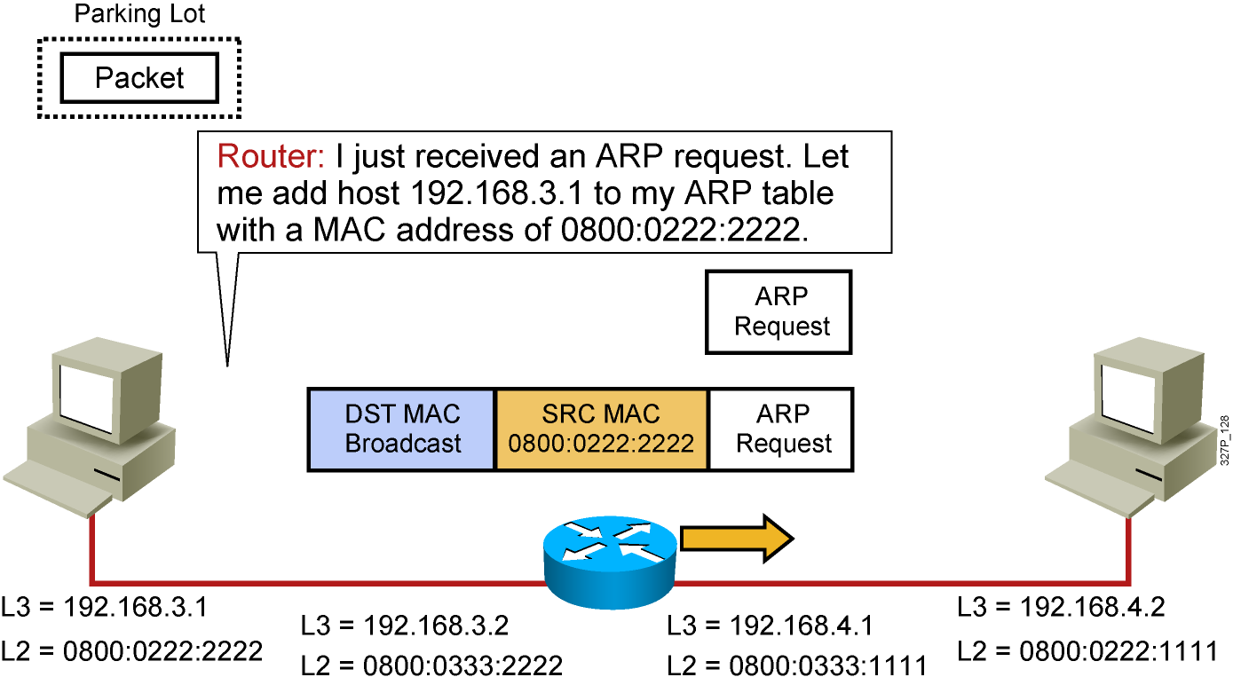
Host-to-Host Packet Delivery (6 of 17)
Notes:
Lesson Aim
<Enter lesson aim here.>

Slide 10
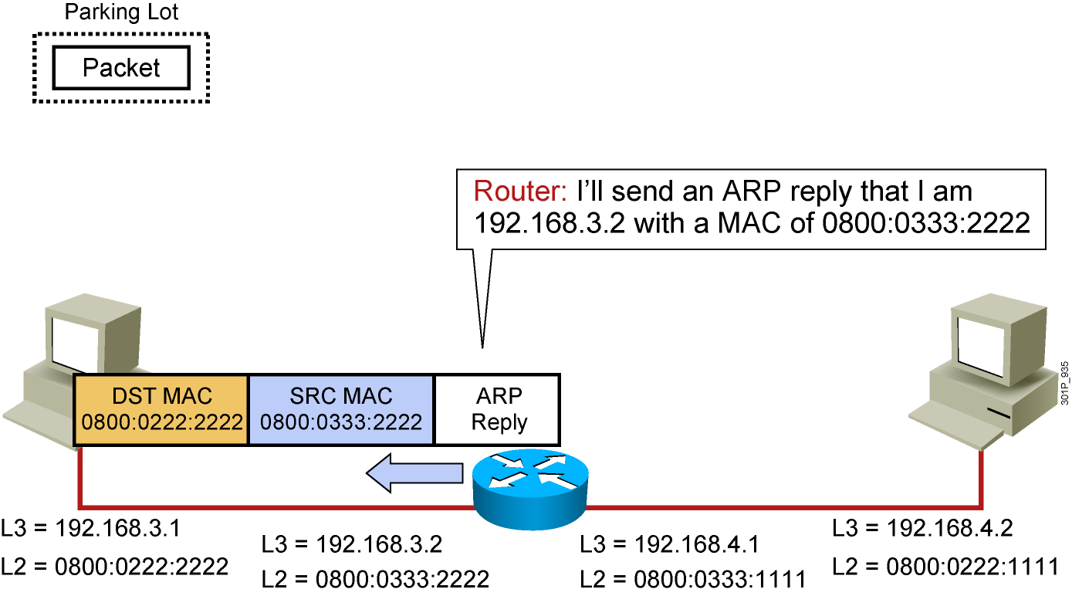
Host-to-Host Packet Delivery (7 of 17)
Notes:
Lesson Aim
<Enter lesson aim here.>

Slide 11
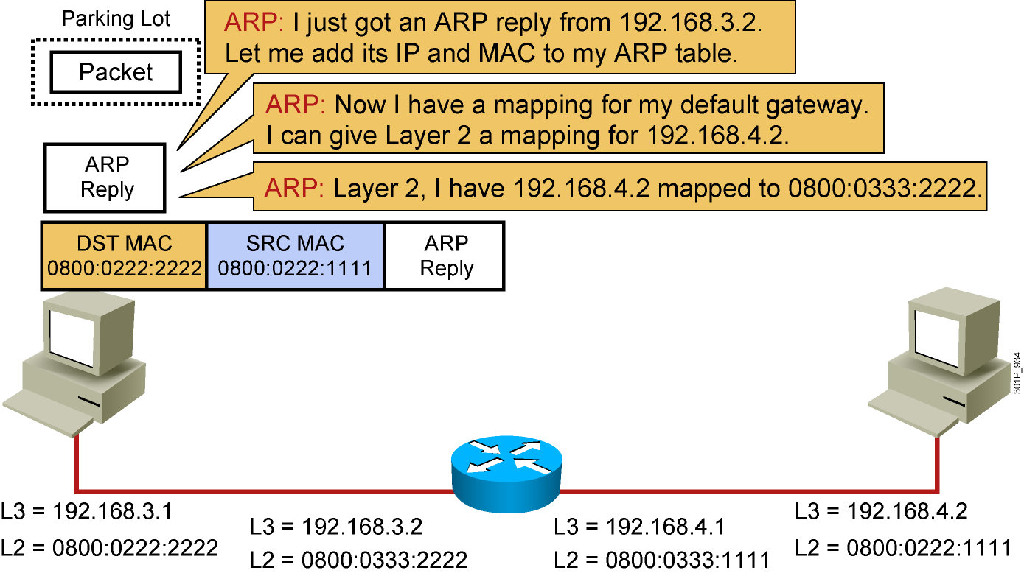
Host-to-Host Packet Delivery (8 of 17)
Notes:
Lesson Aim
<Enter lesson aim here.>

Slide 12
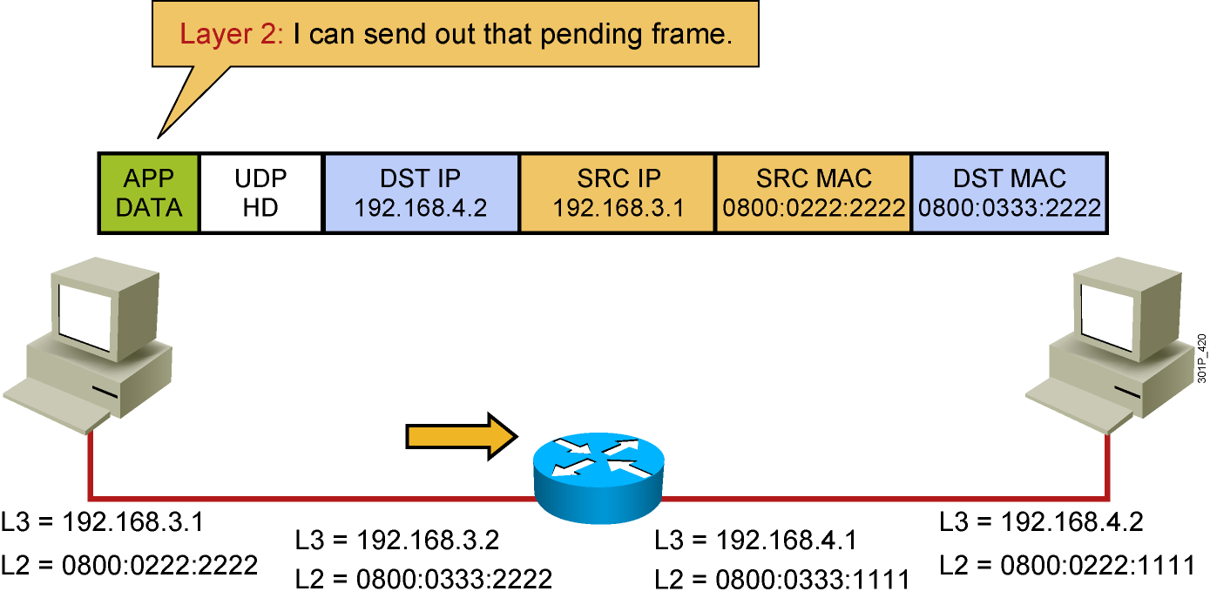
Host-to-Host Packet Delivery (9 of 17)
Notes:
Lesson Aim
<Enter lesson aim here.>

Slide 13
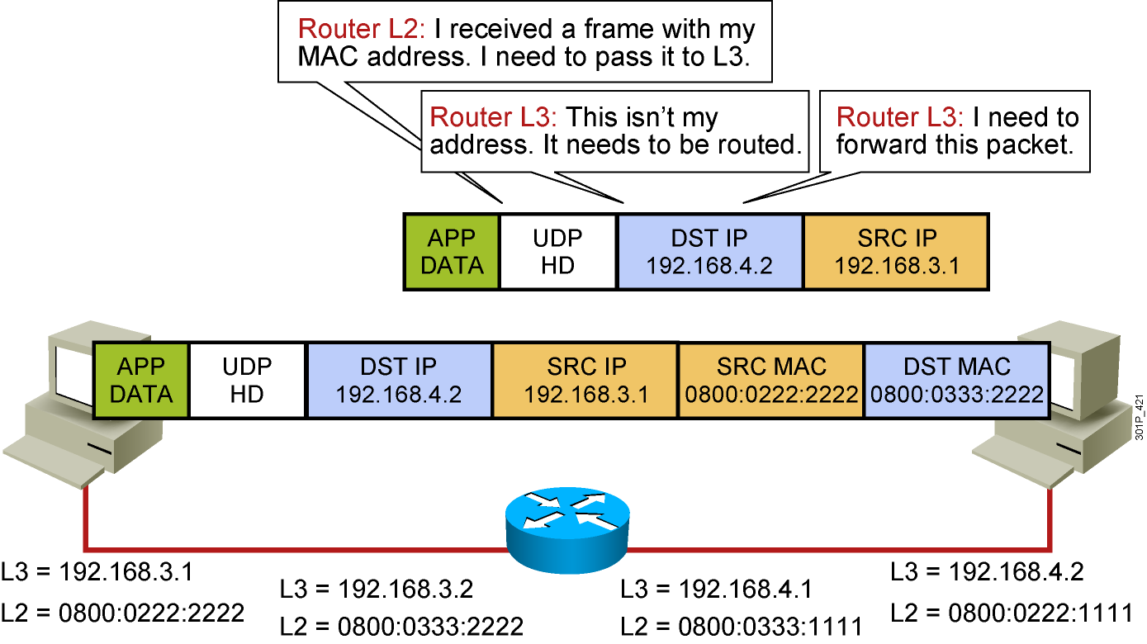
Host-to-Host Packet Delivery (10 of 17)
Notes:
Lesson Aim
<Enter lesson aim here.>

Slide 14
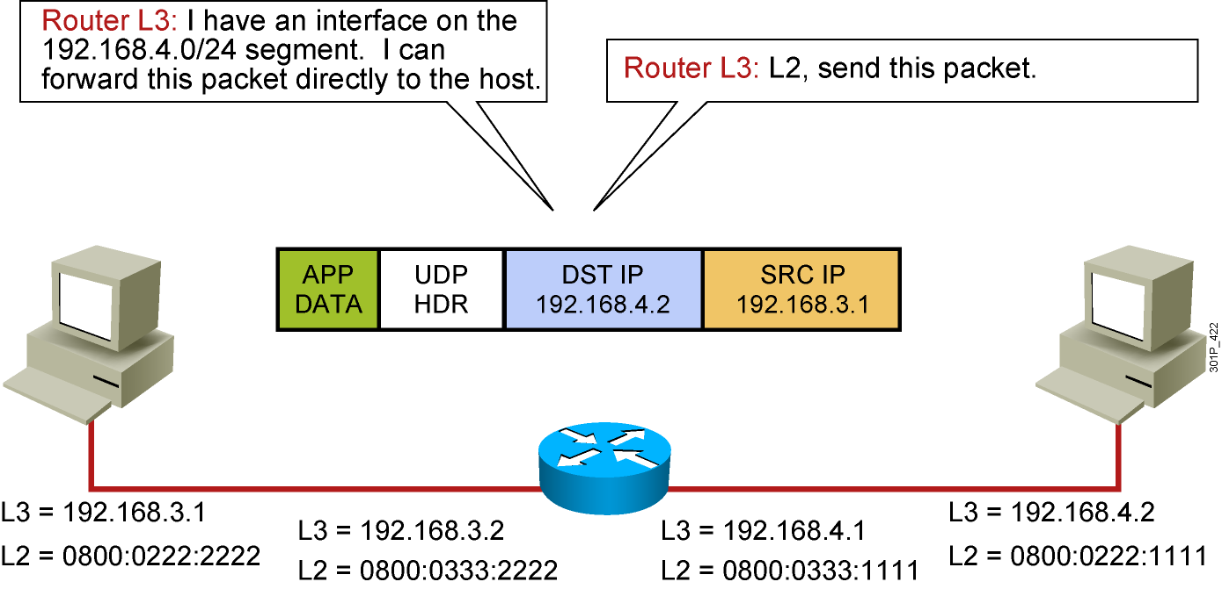
Host-to-Host Packet Delivery (11 of 17)
Destination | Next Hop | Interface
192.168.3.0/24 | Connected | fa 0/0
192.168.4.0/24 | Connected | fa 0/1
Notes:
Lesson Aim
<Enter lesson aim here.>

Slide 15
Host-to-Host Packet Delivery (12 of 17)
Notes:
Lesson Aim
<Enter lesson aim here.>

Slide 16
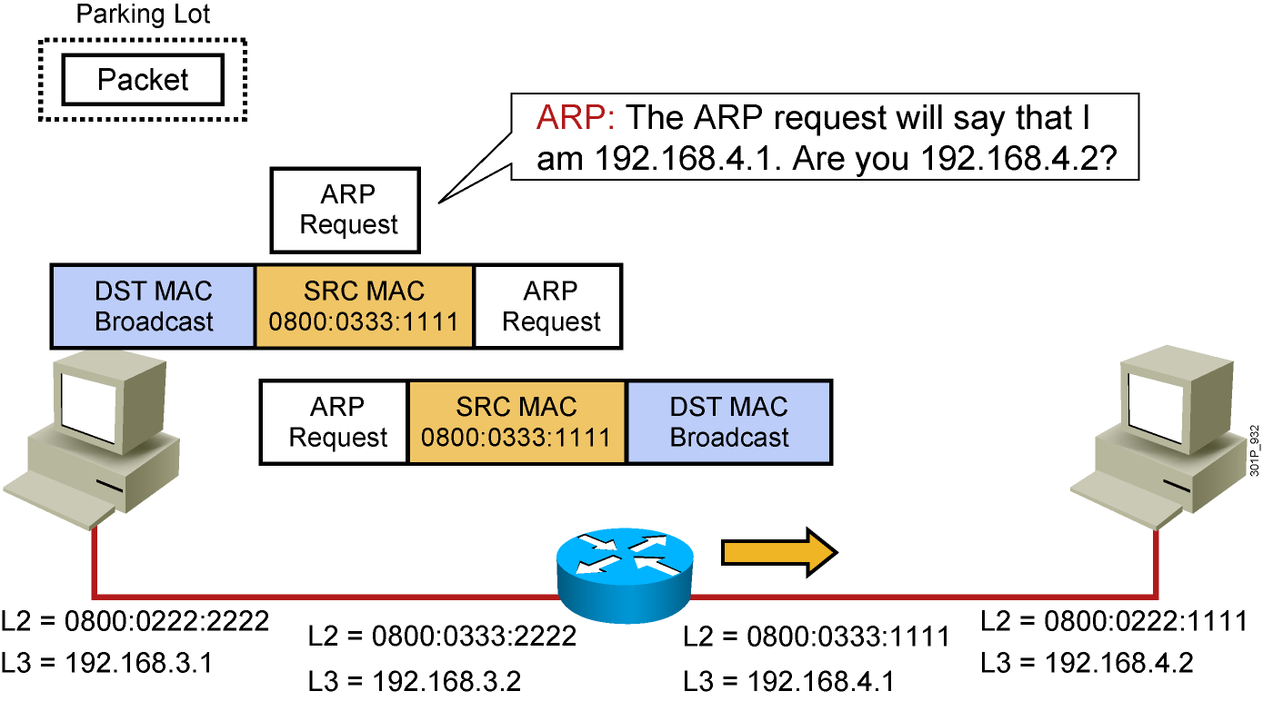
Host-to-Host Packet Delivery (13 of 17)
Notes:
Lesson Aim
<Enter lesson aim here.>

Slide 17
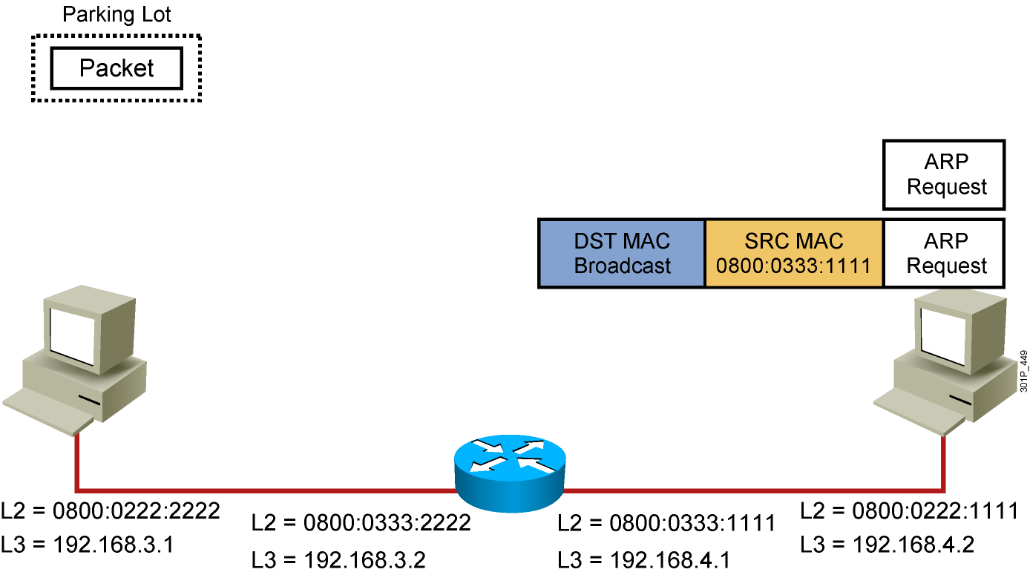
Host-to-Host Packet Delivery (14 of 17)
Notes:
Lesson Aim
<Enter lesson aim here.>

Slide 18
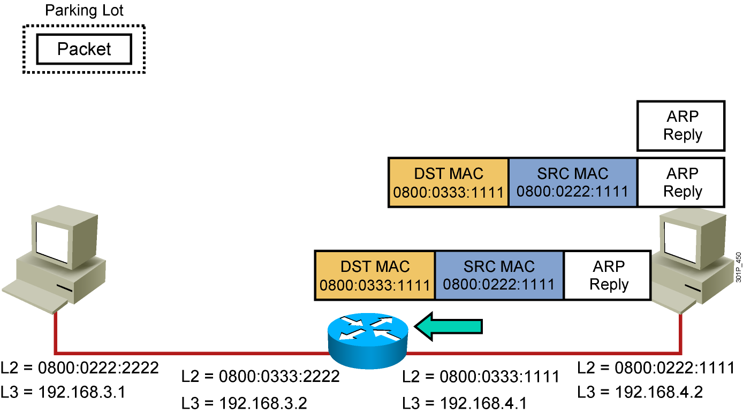
Host-to-Host Packet Delivery (15 of 17)
Notes:
Lesson Aim
<Enter lesson aim here.>

Slide 19
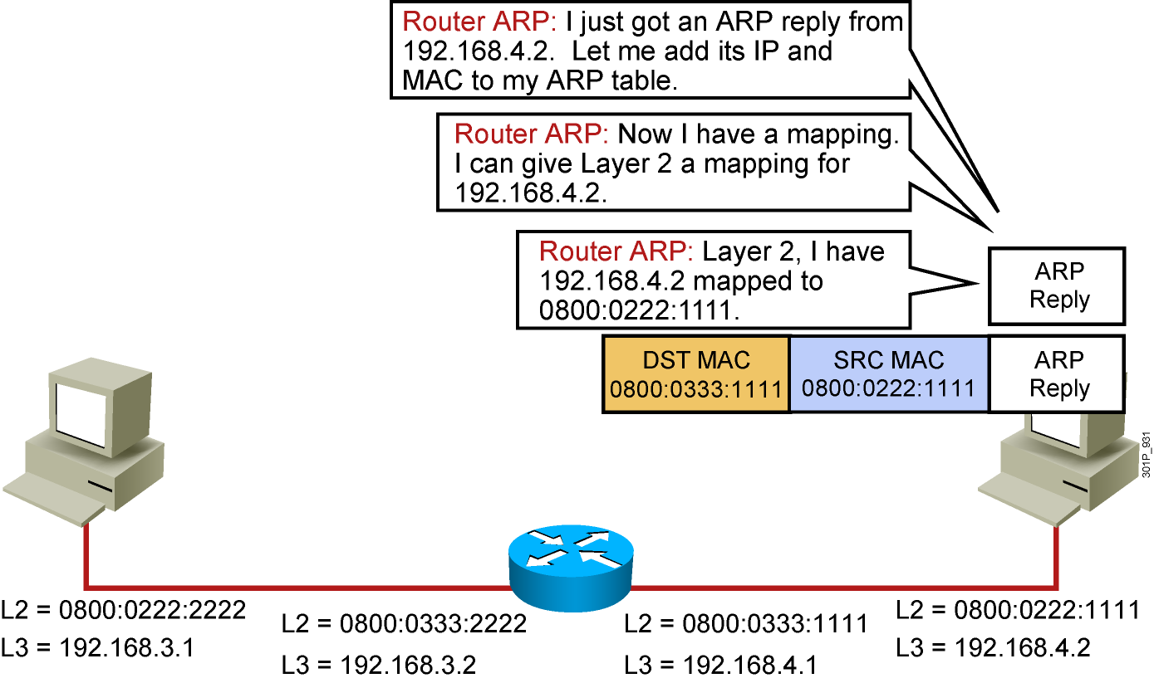
Host-to-Host Packet Delivery (16 of 17)
Notes:
Lesson Aim
<Enter lesson aim here.>

Slide 20
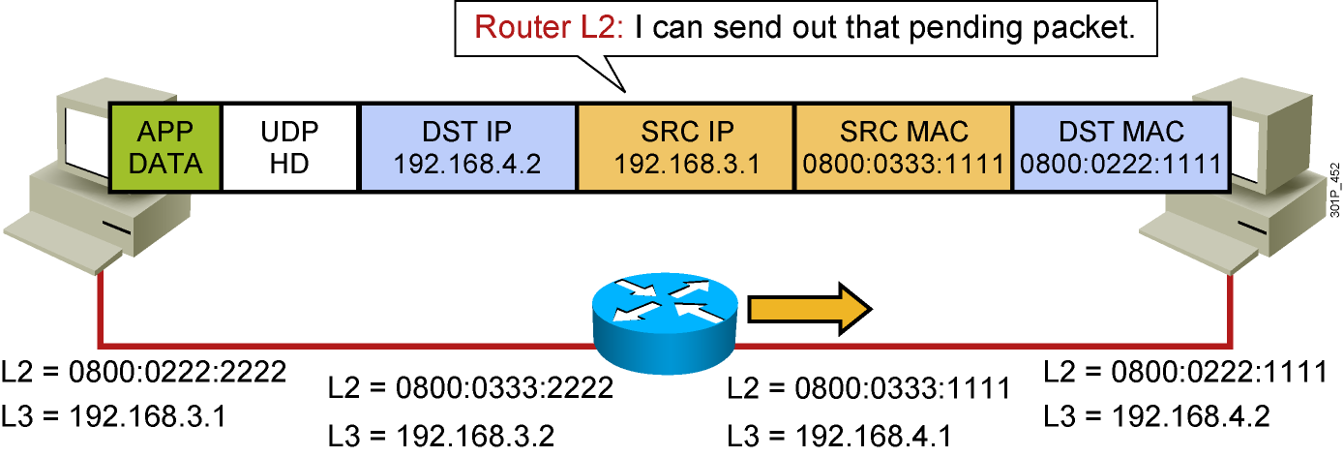
Host-to-Host Packet Delivery (17 of 17)
Notes:
Lesson Aim
<Enter lesson aim here.>

Slide 21
Using the show OP Command
Router# show ip arp
Protocol Address Age(min) Hardware Addr Type Interface
Internet 172.69.233.229 - 0000.0c59.f892 ARPA Ethernet0/0
Internet 172.69.233.218 - 0000.0c07.ac00 ARPA Ethernet0/0
Internet 172.69.233.19 - 0000.0c63.1300 ARPA Ethernet0/0
Internet 172.69.233.309 - 0000.0c36.6965 ARPA Ethernet0/0
Internet 172.19.168.11 - 0000.0c63.1300 ARPA Ethernet0/0
Internet 172.19.168.254 9 0000.0c36.6965 ARPA Ethernet0/0

Slide 22
ping
Router#
ping [[protocol {host-name | system-address}]
  To diagnose basic network connectivity, use the ping command in user EXEC or privileged EXEC mode.

Slide 23
traceroute
Router#
traceroute [protocol] destination
  To discover the routes that packets will actually take when traveling to their destination address, use the traceroute command in user EXEC or privileged EXEC mode.

Slide 24
Summary
  If the hosts are not on the same segment, the frame is sent to the default gateway.
  Packets sent to the default gateway will have the local host source and remote host destination IP address.
  Frames sent to the default gateway will have the local host source and the default gateway MAC address.
  A router will change the Layer 2 address as needed, but will not change the Layer 3 address.
  The show ip arp command displays the mapping between network addresses and MAC addresses that the router has learned.
  Cisco IOS connectivity tools include ping and traceroute.

